Slide 1
3G Wireless Systems
Nachiket Mehta
Wireless Networks CSG250

Slide 2
OUTLINE
3G Overview
  Advantage, Capabilities, Organizations, IMT-2000 radio interface, Technologies, Evolution paths
UMTS-FDD / WCDMA
  Spreading Codes, Physical layer, Mac layer, RLC layer, RRC layer
  Hand Over
  Power Control
  QoS Support
What’s next after 3G?
Summary
References

Slide 3
3G Overview

Slide 4
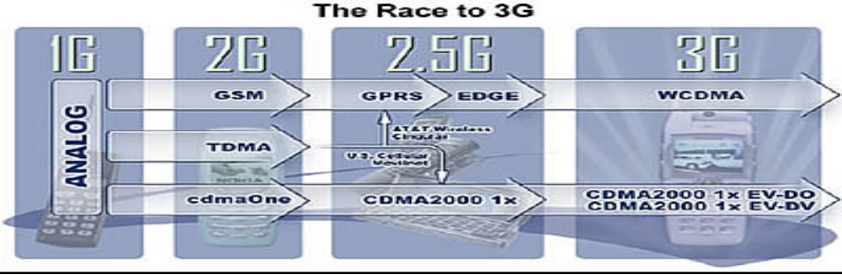
Route to 3G
1G: analog
2G : 1st digital mobile telephony
2.5G: transition from 2G to 3G
3G standard: IMT 2000

Slide 5
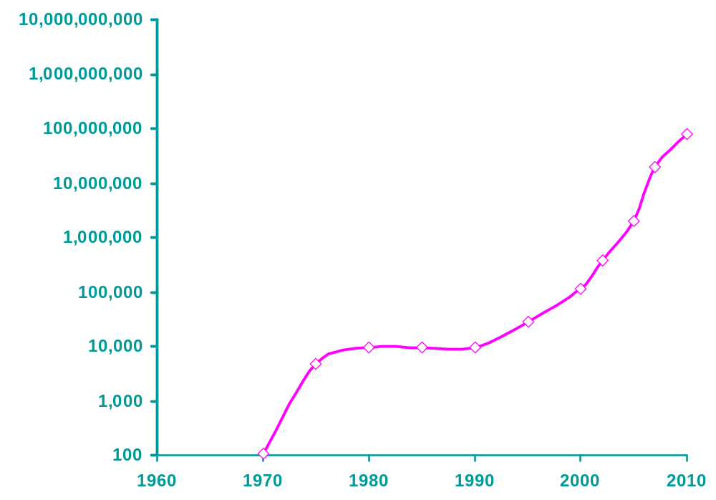
3G & Future Wireless Vs. Bandwidth
4G
3.5G
bps
3G
GPRS
2G

Slide 6
3G- Advantages
3G phones promise :-
Improved digital voice communications
Larger Bandwidth – Higher Data rate
Greater subscriber capacity
Fast packet-based data services like e-mail, short message service (SMS), and Internet access at broadband speeds.
Most carriers also expect consumers to want :-
  location services
  interactive gaming
  streaming video
  home monitoring and control
  and who knows what else, while being fully mobile anywhere in the world.

Slide 7
3G Capabilities
Voice quality comparable to the public switched telephone network
144 Kbps- user in high-speed motor vehicles
384 Kbps- pedestrians standing or moving slowly over small areas
Up to 2 Mbps- fixed applications like office use
Symmetrical/asymmetrical data transmission rates
Support for both packet switched and circuit switched data services like Internet Protocol (IP) traffic and real time video

Slide 8
Organizations
  3G is also known as UMTS (Universal Mobile Telecommunication System)
  3GPP 3rd Generation Partnership Project.
  3GPP2 3rd Generation Partnership Project 2
  Internet Engineering Taskforce (IETF)
  ITU-IMT-2000 Standard (International Telecommunication Union- International Mobile Telecommunication)

Slide 9
IMT-2000 Radio Interface
I M T
Paired Spectrum
Unpaired Spectrum
IMT-DS
UMTS-FDD
(WCDMA)
Direct spread
IMT-MC
CDMA-2000
(1x-EvDO/DV)
Multi carrier
IMT-TC
UMTS-TDD
(TD-SCDMA)
Time code
IMT-SC
UWC-136
(EDGE)
Single carrier
IMT-FT
DECT
Freq. time
CDMA TDMA FDMA

Slide 10
IMT-2000 Frequency Bands
1G + 2G
806
960 MHz
2G (Asia, Europe) + 3G
1710
1885 MHz
WCDMA(UL) 1820-1880MHz
WCDMA(DL) 1910-1970MHz
DECT, PHS + 2G + 3G
1885
2025
2110
2200 MHz
2500
2690 MHz

Slide 11
Technologies
3G is superior to the other digital standards like:-
  GSM (Global System for Mobile) communications standard used worldwide
  And IS-136 TDMA standard used primarily in North America.
3G Technologies:-
  WCDMA or UMTS-FDD (Universal Mobile Telecommunications System - Frequency Division Duplex)---Direct Spread
  CDMA2000 - 1x-EvDO/EvDV---Multi carrier
  UMTS – TDD (Time Division Duplex) or TD-SCDMA (Time Division - Synchronous Code Division Multiple Access) ---Time Code
4G Technologies:-
  Digital Audio Broadcast (DAB) and Digital Video Broadcast (DVB) for wide area broadcasting
  Local Multipoint Distribution System (LMDS)
  Microwave Multipoint Distribution System (MMDS)

Slide 12
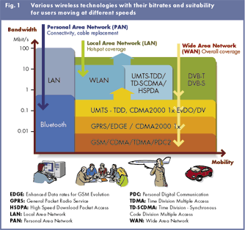
Wireless Technologies (Figure)

Slide 13
Evolution Paths
cdmaOne
IS-95B
cdmaOne
IS-95A
Cdma2000 1X
Cdma2000
1xEV-DO
TDMA
Cdma2000
1xEV-DV
IS-41 Core Network
EDGE
WCDMA
GSM
GPRS
GSM Map Core Network
2G
2.5G
3G

Slide 14
UMTS-FDD / WCDMA
(Universal Mobile Telecommunication Standard- Frequency Division Duplex)

Slide 15
UMTS-FDD / WCDMA
Wideband Direct Sequence Code Division
Multiple Access
Does not assign a specific frequency to each user. Instead every channel uses the full available spectrum. Individual conversations are encoded with a pseudo-random digital sequence
Narrowband option for TDD.

Slide 16
WCDMA Parameters
Channel B.W | 5 MHz
Forward RF Channel Structure | Direct Spread
Chip Rate | 3.84 Mcps
Frame Length | 10 ms (38400 chips)
No. of slots/frame | 15
No. of chips/slot | 2560chips (Max. 2560 bits)
Power Control | Open and fast close loop (1.6 KHz)
Uplink SF | 4 to 256
Downlink SF | 4 to 512

Slide 17
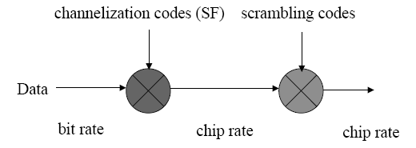
Spreading Operation
Spreading means increasing the signal bandwidth
Strictly speaking, spreading includes two operations:
(1) Channelisation (increases signal bandwidth)
- using orthogonal codes
(2) Scrambling (does not affect the signal bandwidth)
- using pseudo noise codes

Slide 18
Codes
 | Channellization Code | Scrambling Code
Usage | UL: Separation of physical data and control channels from same UE DL: Separation of different users within one cell | UL: Separation of terminals DL: Separation of cells/sectors
Length | UL:4-256 chips DL:4-512 chips | 38400 chips
No. of codes | No. of codes under one scrambling code= SF | UL: Several million DL: 512
Code Family | Orthogonal Variable Spreading Factor | Long 10ms code: Gold code Short code: Extended S(2) code Family
Increase B.W? | YES | NO

Slide 19
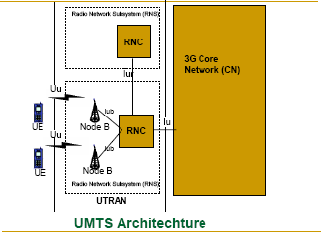
UMTS/IMT-2000 Architecture

Slide 20
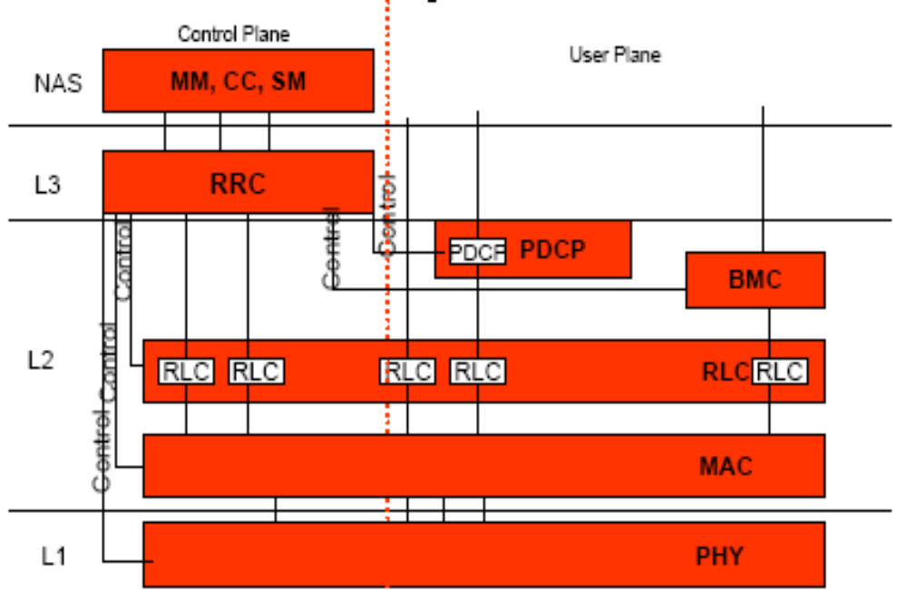
UMTS Protocol Stack

Slide 21
WCDMA : PHYSICAL Layer

Slide 22
Physical Layer
The physical layer offers information transfer services to the MAC layer. These services are denoted as Transport channels (TrCh’s). There are also Physical channels.
Physical layer comprises following functions:
  􀂉 Various handover functions
  􀂉 Error detection and report to higher layers
  􀂉 Multiplexing of transport channels
  􀂉 Mapping of transport channels to physical channels
  􀂉 Fast Close loop Power control
  􀂉 Frequency and Time Synchronization
  􀂉 Other responsibilities associated with transmitting and receiving signals over the wireless media.

Slide 23
Transport & Physical Channels
Transport Channel | Physical Channel
(UL/DL) Dedicated Channel DCH | Dedicated Physical Data Channel DPDCH Dedicated Physical Control Channel DPCCH
(UL) Random Access Channel RACH | Physical random access channel PRACH
(UL) Common packet channel CPCH | Physical common packet channel PCPCH
(DL) Broadcast channel BCH | Primary common control physical channel P-CCPCH
(DL) Forward access channel FACH (DL) Paging channel PCH | Secondary common control physical channel S-CCPCH
(DL) Downlink shared channel DSCH | Physical downlink shared channel PDSCH
Signaling physical channels | Synchronization channel SCH Common pilot channel CPICH Acquisition indication channel AICH Paging indication channel PICH CPCH Status indication channel CSICH Collision detection/Channel assignment indicator channel CD/CA-ICH

Slide 24
WCDMA : MAC Layer

Slide 25
MAC Layer
The MAC layer offers Data transfer to RLC and higher layers.
The MAC layer comprises the following functions:
  Selection of appropriate TF (basically bit rate), within a predefined set, per information unit delivered to the physical layer
  Service multiplexing on RACH, FACH, and dedicated channels
  Priority handling between ‘data flows’ of one user as well as between data flows from several users—the latter being achieved by means of dynamic scheduling
  Access control on RACH
  Address control on RACH and FACH
  Contention resolution on RACH

Slide 26
WCDMA : RLC Layer

Slide 27
RLC Layer
The RLC layer offers the following services to the higher layers:
  Layer 2 connection establishment/release
  Transparent data transfer, i.e., no protocol overhead is appended to the information unit received from the higher layer
  Assured and un assured data transfer
The RLC layer comprises the following functions:
  Segmentation and assembly
  Transfer of user data
  Error correction by means of retransmission optimized for the WCDMA physical layer
  Sequence integrity (used by at least the control plane)
  Duplicate detection
  Flow control
  Ciphering

Slide 28
WCDMA : RRC Layer

Slide 29
RRC Layer
The RRC layer offers the core network the following services:
  General control service, which is used as an information broadcast service
  Notification service, which is used for paging and notification of a selected UEs
  Dedicated control service, which is used for establishment/release of a connection and transfer of messages using the connection.
The RRC layer comprises the following functions:
  Broadcasting information from network to all UEs
  Radio resource handling (e.g., code allocation, handover, admission control, and measurement reporting/control)
  QoS Control
  UE measurement reporting and control of the reporting
  Power Control, Encryption and Integrity protection

Slide 30
WCDMA : Hand Over

Slide 31
Hand Over
Intra-mode handover
  Include soft handover, softer handover and hard handover.
  Rely on the Ec/No measurement performed from the CPICH.
Inter-mode handover
  Handover to the UTRA TDD mode.
Inter-system handover
  Handover to other system, such as GSM.
  Make measurement on the frequency during compressed mode.

Slide 32
WCDMA : Power Control

Slide 33
Power Control
Fast Closed Loop PC – Inner Loop PC
  Feedback information.
  Uplink PC is used for near-far problem. Downlink PC is to ensure that there is enough power for mobiles at the cell edge.
Two special cases for fast closed loop PC:
  Soft handover:- how to react to multiple power control commands from several sources. At the mobile, a “power down” command has higher priority over “power up” command.
  Compressed mode:- Large step size is used after a compressed frame to allow the power level to converge more quickly to the correct value after the break.

Slide 34
Power Control (Contd.)
Open loop PC
  No feedback information.
  Make a rough estimate of the path loss by means of a downlink beacon signal.
  Provide a coarse initial power setting of the mobile at the beginning of a connection.
  Apply only prior to initiating the transmission on RACH or CPCH.

Slide 35
WCDMA : QoS Support

Slide 36
UMTS/WCDMA QoS
The standard provides an overview of the functionality needed to establish, modify and maintain a UMTS link with a specific QoS.
Divided into:
  Control plane
    Managing, translating, admitting and controlling users requests and network resources.
  User plane
    QoS signaling and monitoring of user data traffic

Slide 37
QoS Classes
Conversational (real time):-
  VoIP
  Telephony
  Video conferencing
􀂄 Streaming (real time):-
  Video and audio streams
􀂄 Interactive:-
  Web browsing
  Data retrieval
  Server access
􀂄 Background:-
  Download of emails and files

Slide 38
What next after 3G?
The future path has fractured
into a number of possibilities
Operators and vendors must
create viable strategies to
prosper within this complexity
3G &
WLAN &
Brdcst
3G &
WLAN &
Ad-hoc
4G &
WLAN &
Brdcst
2.5G &
WLAN
?
3G+ &
WLAN &
Ad-hoc
4G &
WLAN &
Ad-hoc
3G &
WLAN
3G+ &
WLAN
GPRS/
EDGE
(2.5G)
4G &
WLAN
3G+
GSM
(2G)
W-CDMA
(3G)
4G
1990
2000
2010

Slide 39
4G Air Interface
Higher bit rates than 3G (20 Mbps < peak < 200 Mbps)
Higher spectral efficiency and Lower Cost per bit than 3G
Air interface and MAC optimized for IP traffic
  Adaptive modulation/coding with power control, hybrid ARQ
Smaller cells, on average, than 3G
  However, cell size will be made as large as possible via:
    High power base station to boost downlink range
    Asymmetry - used to boost uplink range when necessary
    Adaptive antennas option
Higher frequency band than 3G (below 5 GHz preferred)
RF channel bandwidths of 20 MHz and higher
Frequency Domain methods:
  OFDM is promising for downlink

Slide 40
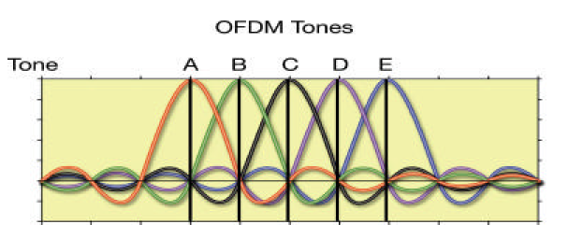
OFDM
Divides the spectrum into a number of equally spaced tones.
Each tone carries a portion of data.
A kind of FDMA, but each tone is orthogonal with every other tone. Tones can overlap each other.
Example: 802.11a WLAN
Notes:
Do not need frequency guard

Slide 41
Summary
3G wireless services are rapidly spreading the global market place with CDMA as the preferred technology solution
The following are the key 3G Technologies that have emerged to be the key commercial players:
  CDMA2000 1X
  CDMA2000 1xEV-DO
  UMTS/WCDMA
WCDMA is one of them, which provides:-
  Larger Bandwidth – Higher Data rate – Lower cost
  Greater subscriber capacity
  IMT-2000 Radio interface standard offers 3G standard
  Hand Over, Power Control problems are addressed
  QoS offered But Customers really want them?
4G still in a formative stage (commercial 2010)
Frequency bands less than 5 GHz preferred for wide-area, mobile services
4G system bandwidth between 20 and 100 MHz
Lower cost per bit than 3G

Slide 42
References
Websites:-
http://www.sss-mag.com
www.electronicdesign.com
www.3g-generation.com
www.3gtoday.com
http://www.pctechguide.com
Articles:-
Latest Trends and New Enhancements in 3G Wireless Communications- By Rao Yallapragada, QualComm
WCDMA—The Radio Interface for Future Mobile Multimedia Communications-By Erik Dahlman, Per Beming, Jens Knutsson, Fredrik Ovesj¨o, Magnus Persson, and Christiaan Roobol
UMTS -Mobile Telematics 2004-Anne Nevin
Fourth Generation Cellular Systems:
Spectrum Requirements-By Joseph M. Nowack-Motorola Labs
IMT Project. What is IMT-2000, Geneva-2001
WCDMA-Physical Layer- By Peter Chong, Ph.D. (UBC, Canada)
3G-4G wireless, COMPT 880 Presentation- By Simon Xin Cheng,Simon Fraser University

Slide 43
THANK YOU!
Wireless Networks CSG250

